Slide 1
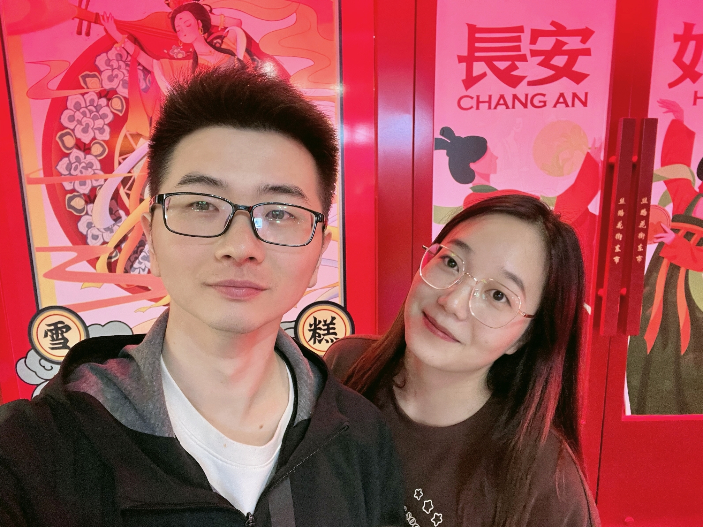
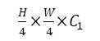
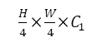

CN-1
CN-2
CN-3
CN-4
RGB input
LAFS
CMA-3
LAFS
CMA-1
LAFS
CMA-2
LAFS
CMA-3
RGB input
RGB input
MF-1
MF-2
MF-3
MF-4
Depth input
Shallow Feature
1.AysmFORMER AysmFORMER
2.AysmFORMER
CN
2.AysmFORMER
LAFS
1.AysmFORMER AysmFORMER AysmFO
MF
Mix ysmFORMER
a) Overall Fra Overall Fra
RGB
RGB
K1
Softmax
M
C
C
C
K1
C
DEPTH
DEPTH
K1
Fused-2
C
M
K1
Softmax
MF
M
Fused-1
MF
M
C
+
1.AysmFORMER AysmFORMER
2.CysmFORMER AysmFORMER
T
S
+
2.AysmFORMER
2.AysmFORR
2.AysmFORMER
M
2.AysmFORMER
C
2.AysmFORMER
b) Dverall Fra Overall Fra

Slide 2
CN-1
CN-2
CN-3
CN-4
RGB input
LAFS
CMA-3
LAFS
CMA-1
LAFS
CMA-2
LAFS
CMA-3
RGB input
RGB input
MF-1
MF-2
MF-3
MF-4
Depth input
Shallow Feature
1.AysmFORMER AysmFORMER
2.AysmFORMER
CN
2.AysmFORMER
LAFS
1.AysmFORMER AysmFORMER AysmFO
MF
Mix ysmFORMER
a) Overall Fra Overall Fra
RGB
RGB
K1
Softmax
M
C
C
C
K1
C
DEPTH
DEPTH
K1
Fused-2
C
M
K1
Softmax
C
MF
M
Fused-1
MF
M
C
+
1.AysmFORMER AysmFORMER
2.CysmFORMER AysmFORMER
T
S
+
2.AysmFORMER
2.AysmFORR
2.AysmFORMER
M
2.AysmFORMER
C
2.AysmFORMER
b) Dverall Fra Overall Fra

Slide 3
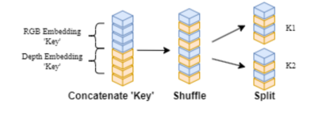
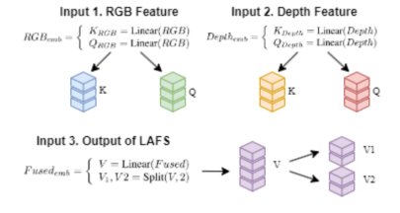
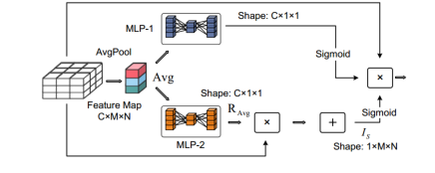
gather
gather

Slide 5
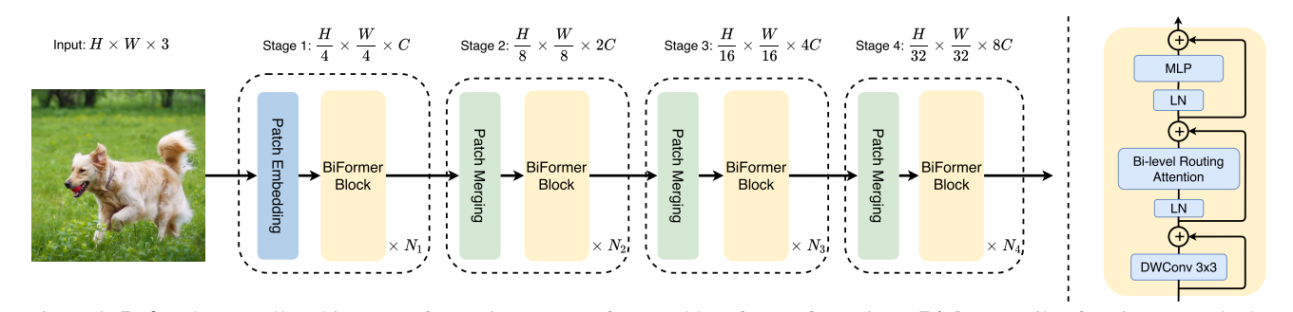
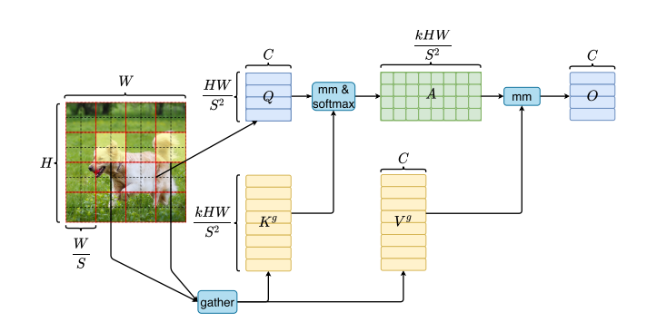
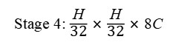
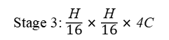
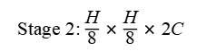
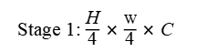
Input: H × W × 3
Stage 1: $\frac{\text{H}}{\text{4}}$ × $\frac{W}{\text{4}}$ × C
Stage 2: $\frac{\text{H}}{\text{8}}$ × $\frac{\text{H}}{\text{8}}$ × 2C
Stage 3: $\frac{\text{H}}{\text{16}}$ × $\frac{\text{H}}{\text{16}}$ × 4C
Stage 4: $\frac{\text{H}}{\text{32}}$ × $\frac{\text{H}}{\text{32}}$ × 8C
＋
MLP
Patch Embedding
Patch Embedding
Patch Embedding
Patch Embedding
LN
Bi-level Routing Attention
BiFormer Block
BiFormer Block
BiFormer Block
BiFormer Block
＋
LN
× N₁
× N₂
× N₃
× N₄
DWConv3×3
＋

Slide 6
mm & softmax
mm
gather

Slide 7
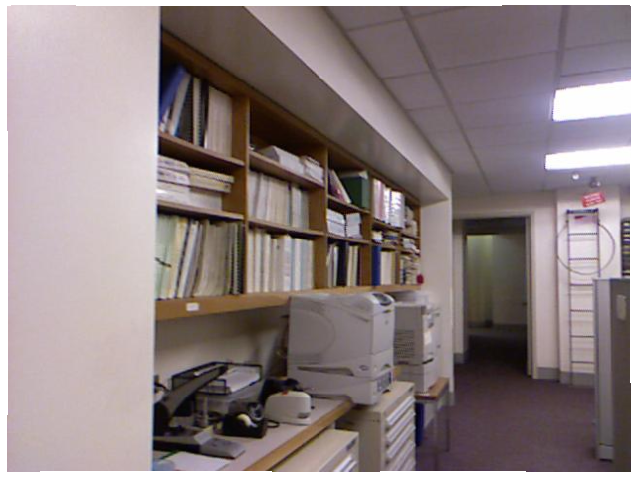
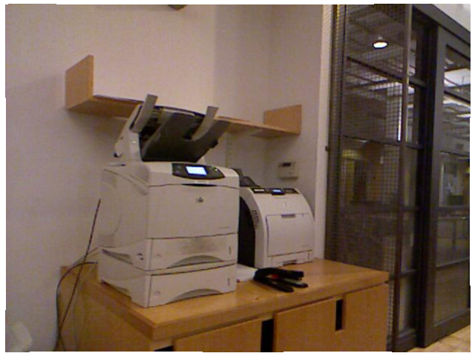
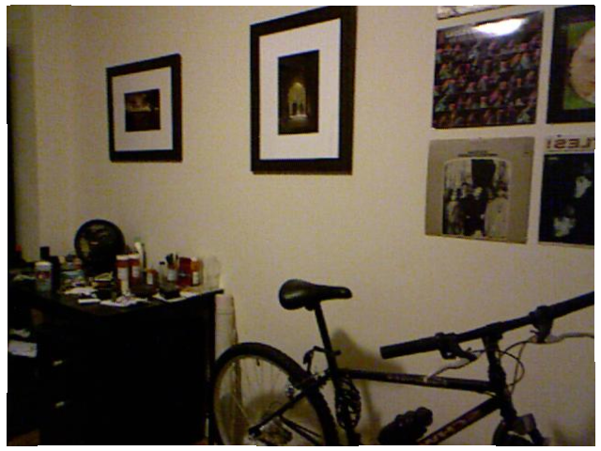
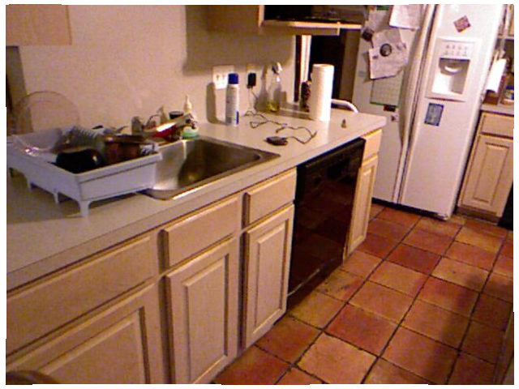
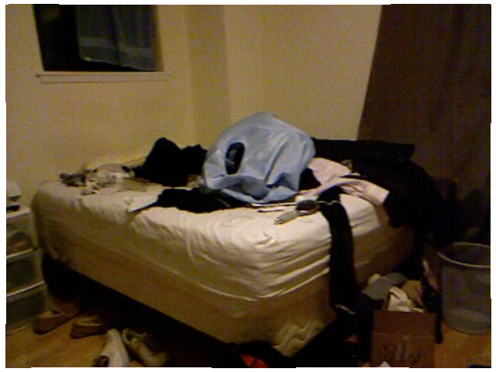
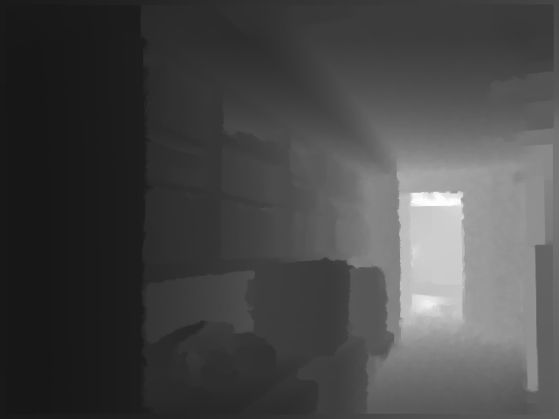
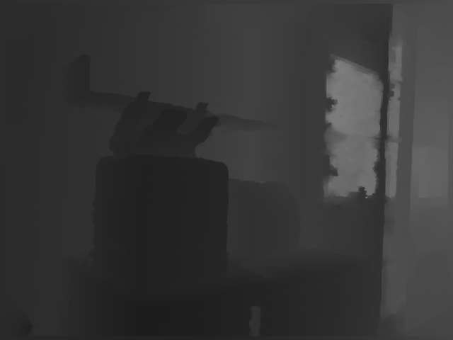
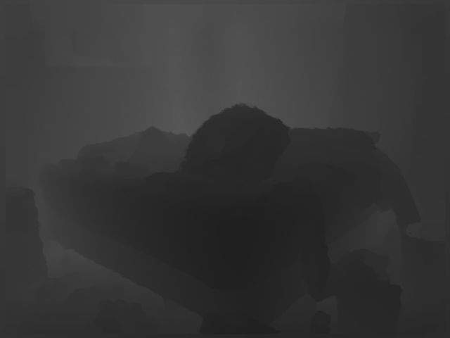

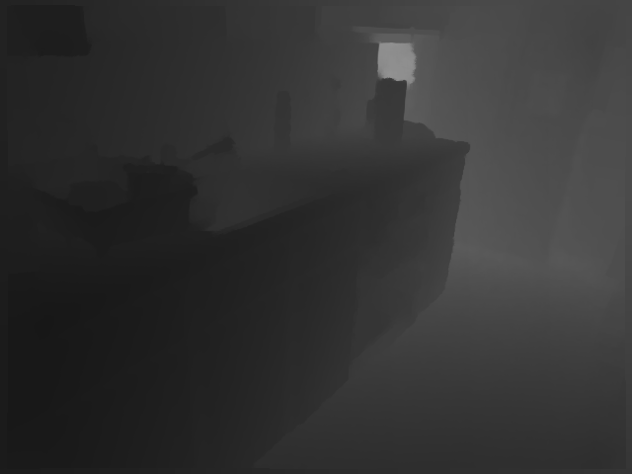
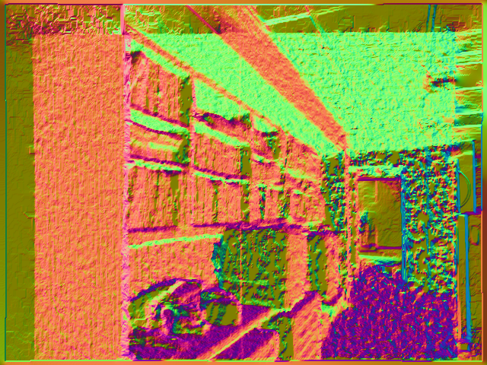
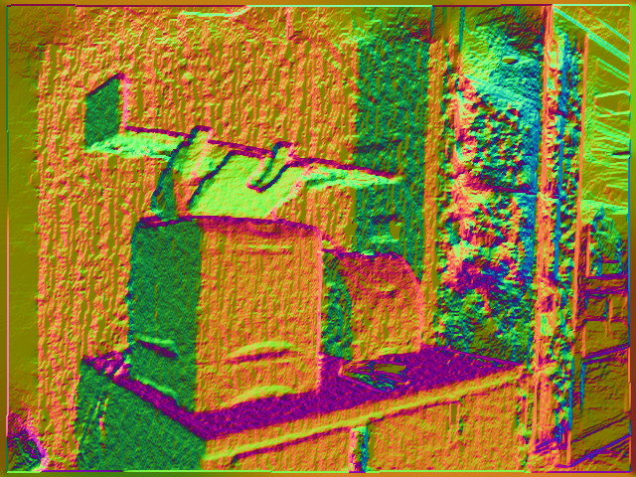
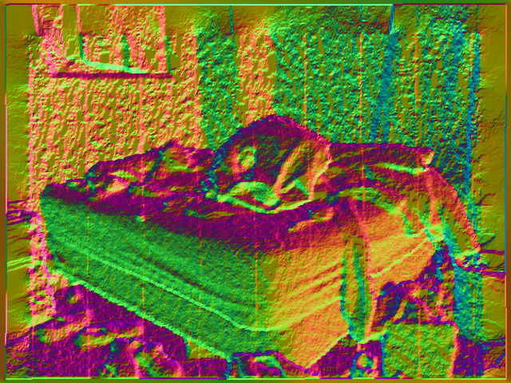
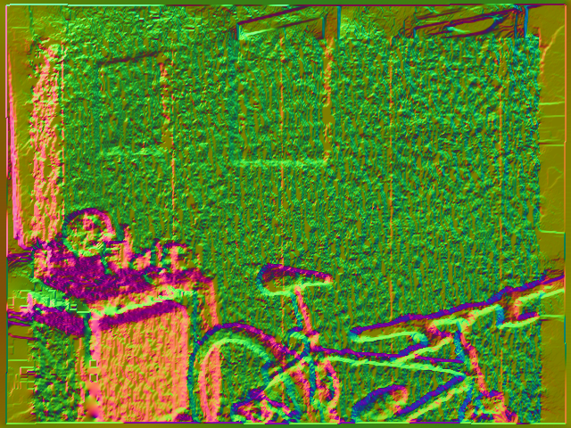
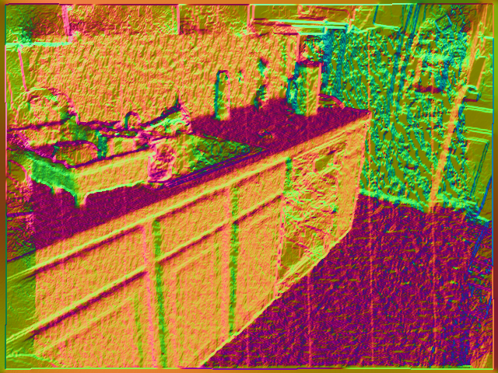
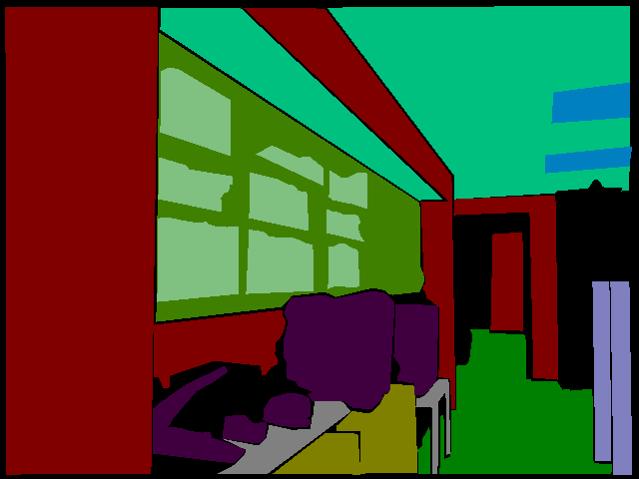
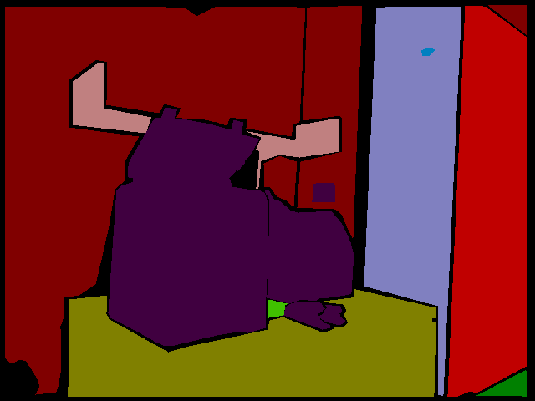
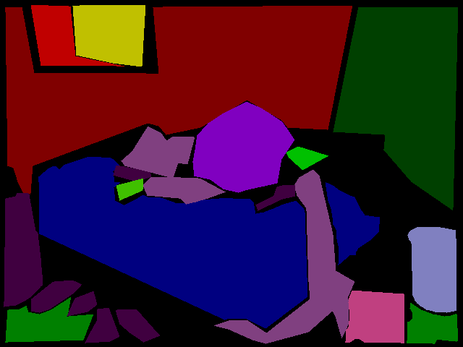
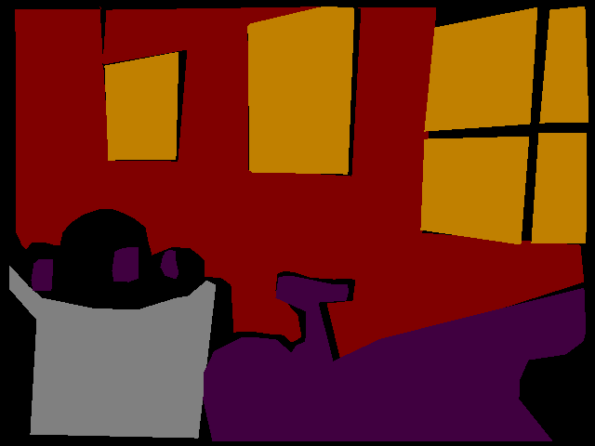
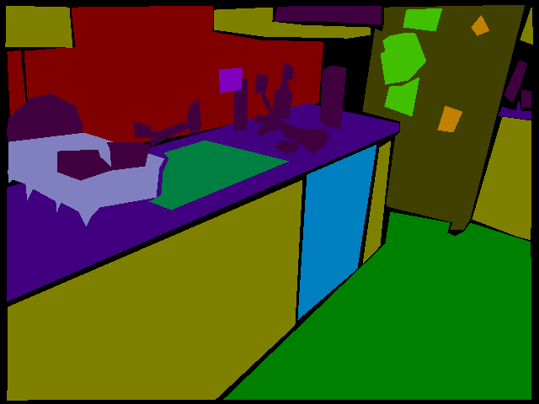
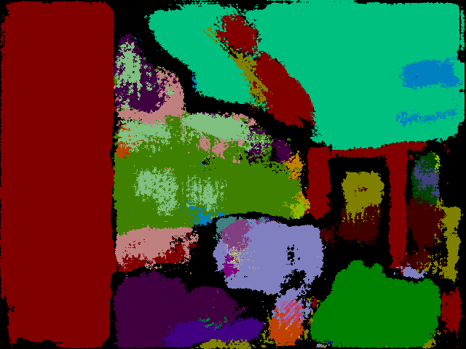
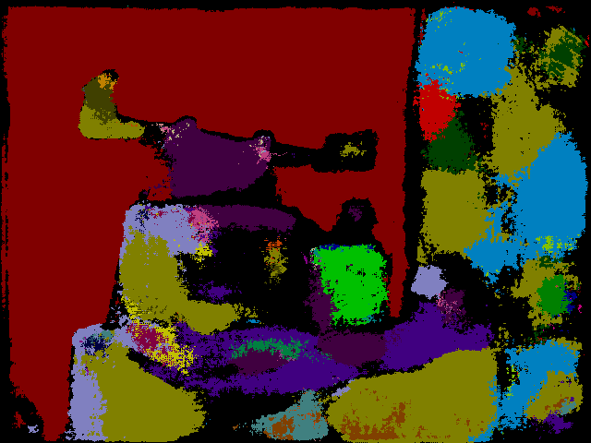
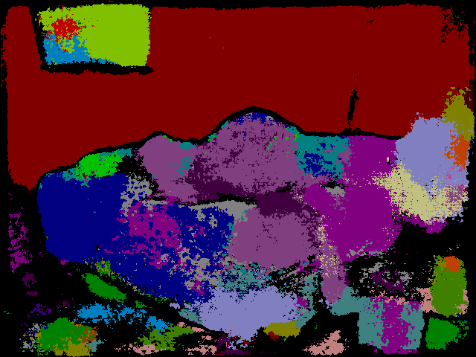
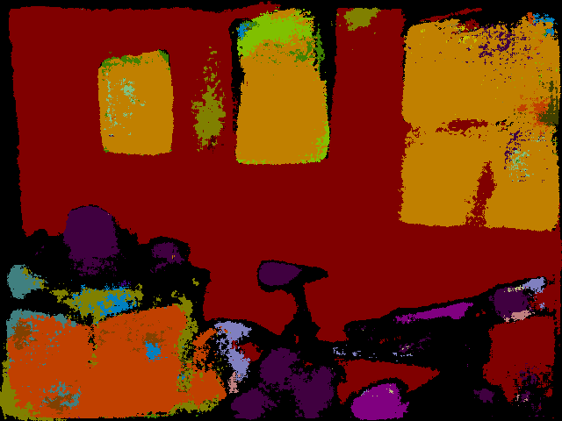
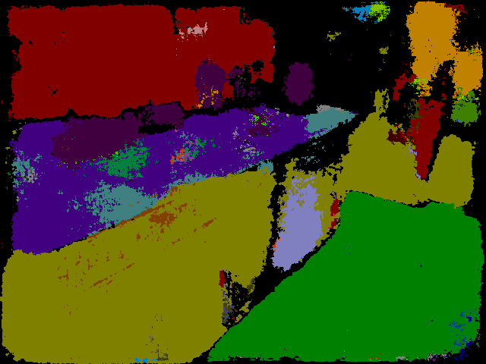
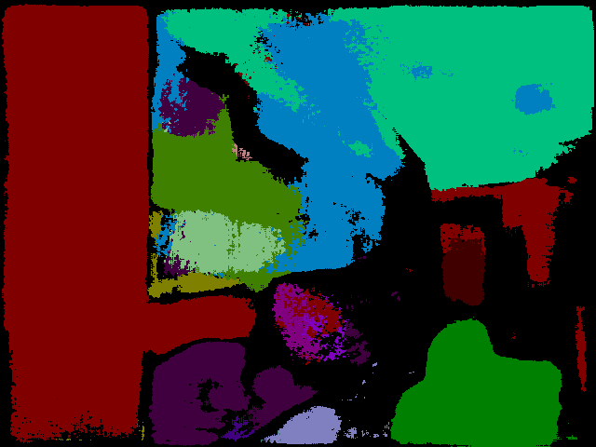
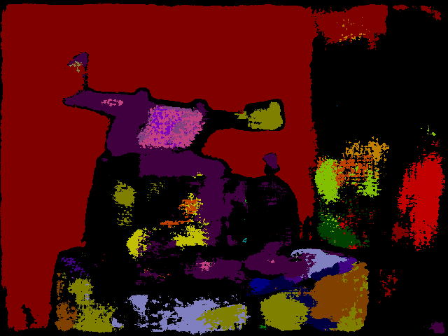
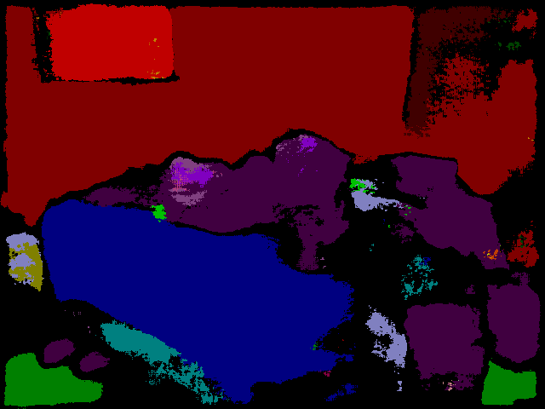
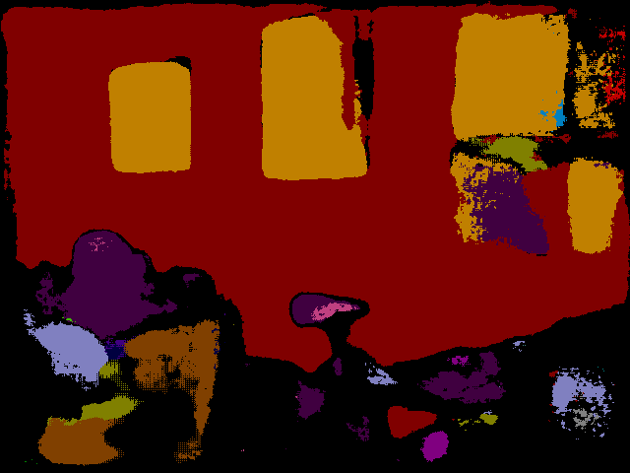
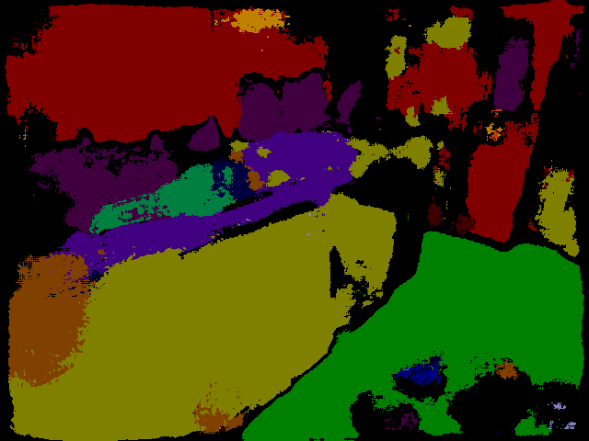
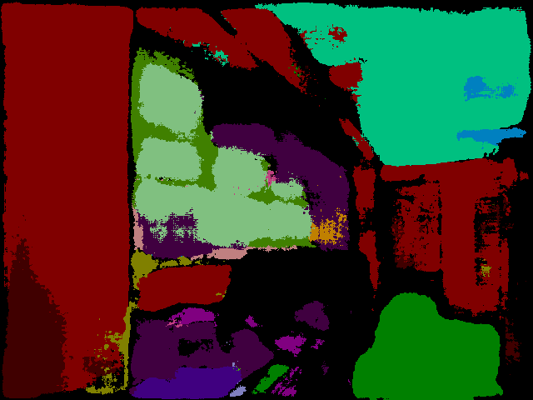
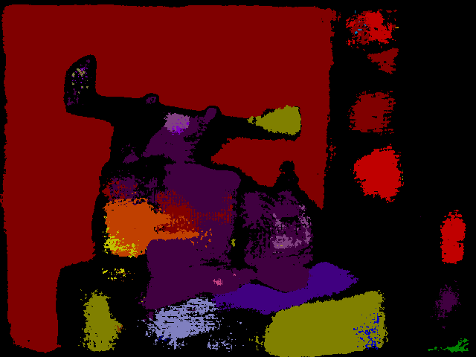
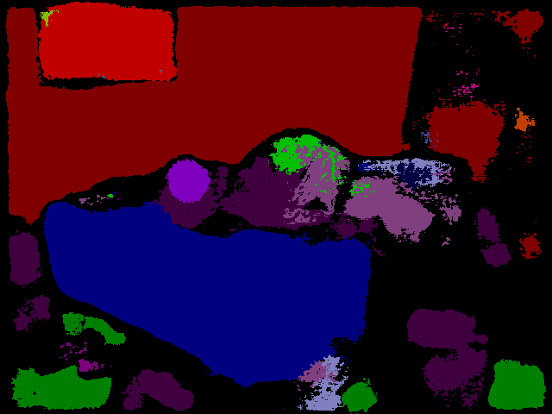
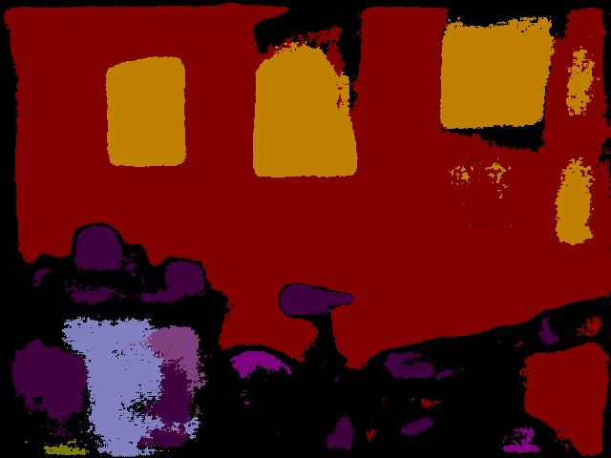
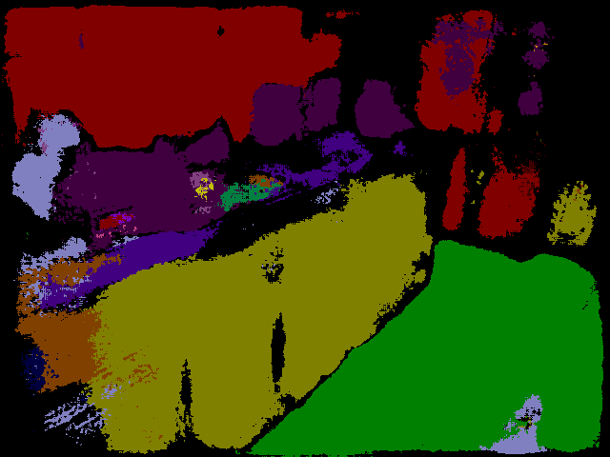
RGB
Depth
Normal
Ground Truth
SegNet
RGBDN
Ours RGBD
Ours RGBDN

Slide 8
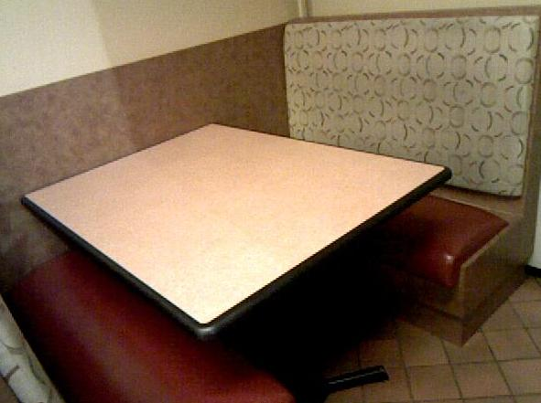
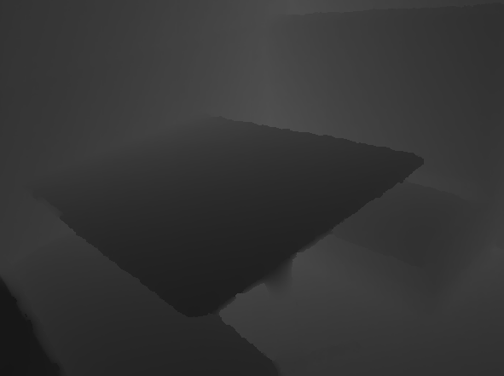
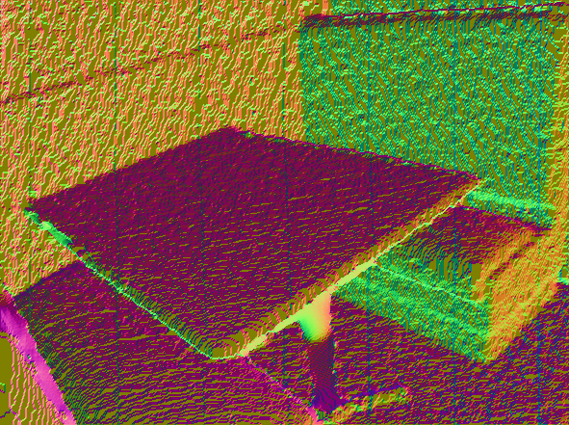
Inputs
Feature maps
Channel exchanging
Part1
Part2
Part3
Modality A
H
C
W
Modality B
Modality C

Slide 9
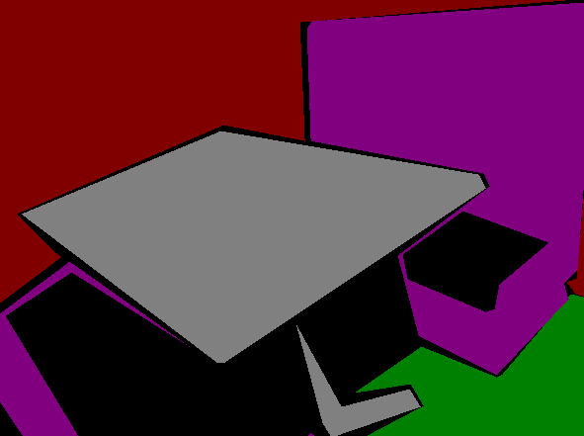
Inputs
Output
Convolutional Encoder-Decoder
RGB
Pooling Indices
Depth
Normal
Conv + BN + Channel Exchanging + ReLU
Pooling Upsampling Softmax
Semantic
segmentation

